Slide 1
Face Swapping
By –
Aditi Rastogi – RA1911003010219
Shresth Kapoor – RA1911003010220
Arsh Chauhan – RA1911003010222

Slide 2
Abstract
The following program is used to swap the faces from two images.
Filters of such kind are widely used on different social media platforms like Snapchat, Instagram, Facebook etc.
With this project, people can make their own face filters for social media.

Slide 3
Objective
In today's world deep fake technology has become really popular . As a result the demand for such types of software's has increased as being able to go back and change the faces in a video or movie without the need for a reshoot and creating entire videos . This is where our software comes in use. Our project involves Machine learning algorithms along with OpenCV and dlib libraries to get accurate result.

Slide 4
Python dependencies
Python libraries used in the project are –
NumPy
Open CV
dlib
Image IO
Matplotlib

Slide 5
Methodology
Take two images – one as the source and another as a destination.
Use the dlib landmark detector on both these images.
Join the dots in the landmark detector to form triangles.
Extract these triangles
Place the source image on the destination
Smoothen the face

Slide 6
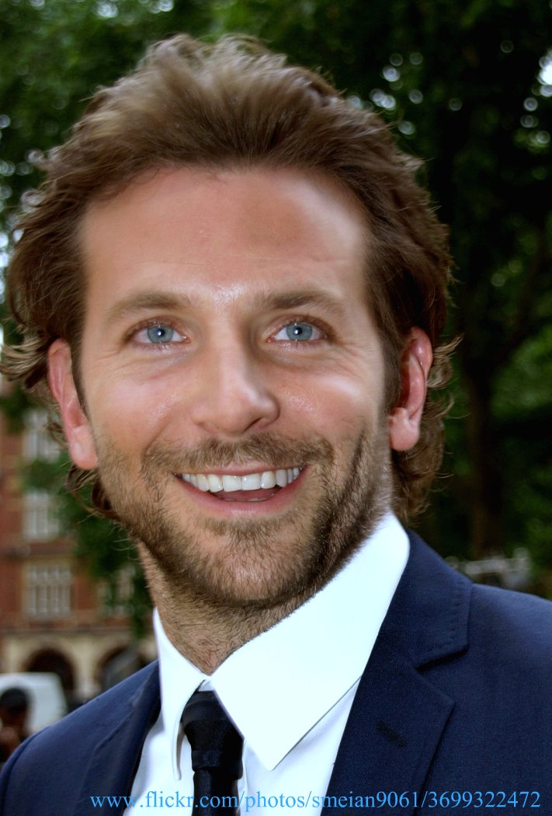
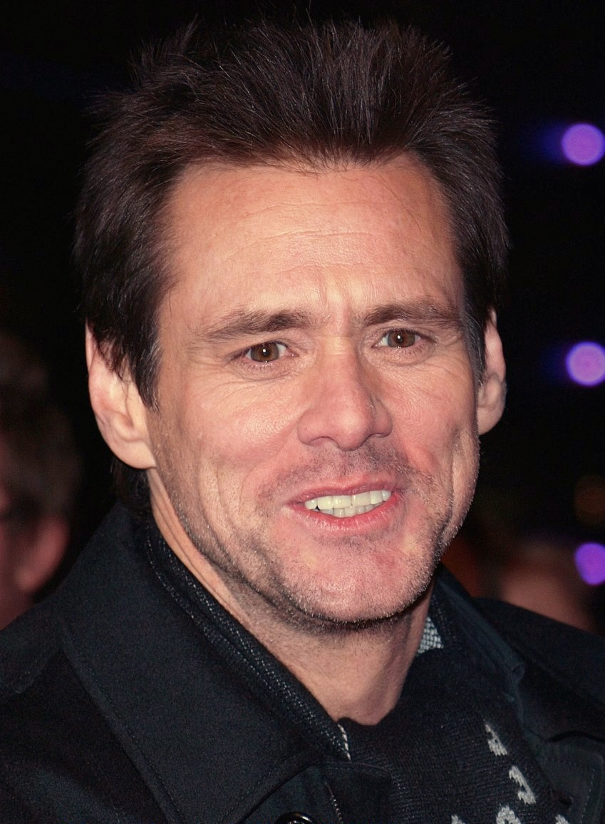
Result
Original Images –
Jim Carrey
Bradley Cooper
Jim Carrey
Bradley Cooper

Slide 7
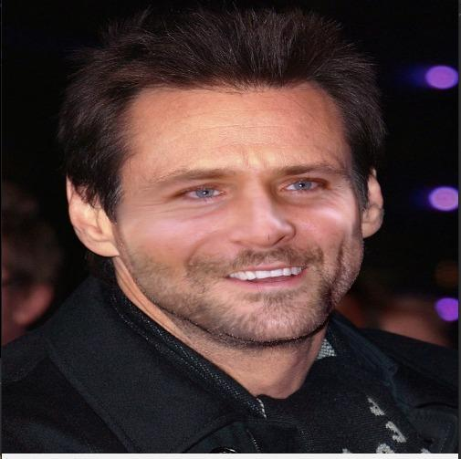
Output -

Slide 8
Conclusion
Our project is a face swapping program developed using OpenCV where the user can take two images of different persons and then swap the faces . Our project enables the users to create multiple filters of their face and also swap their face with that of any personality of their choices for purely entertainment purposes.

Slide 9
References
Research paper to accompany this project is available here.

